Slide 1



ALICE Beam Simulations
Deepa Angal-Kalinin
On behalf of ALICE simulation team
F. Jackson, J. Jones, J. McKenzie, B. Muratori, Y. Saveliev,
P. Williams, A. Wolski
FLS2012, Jefferson Lab, 5th -9th March 2012

Slide 2
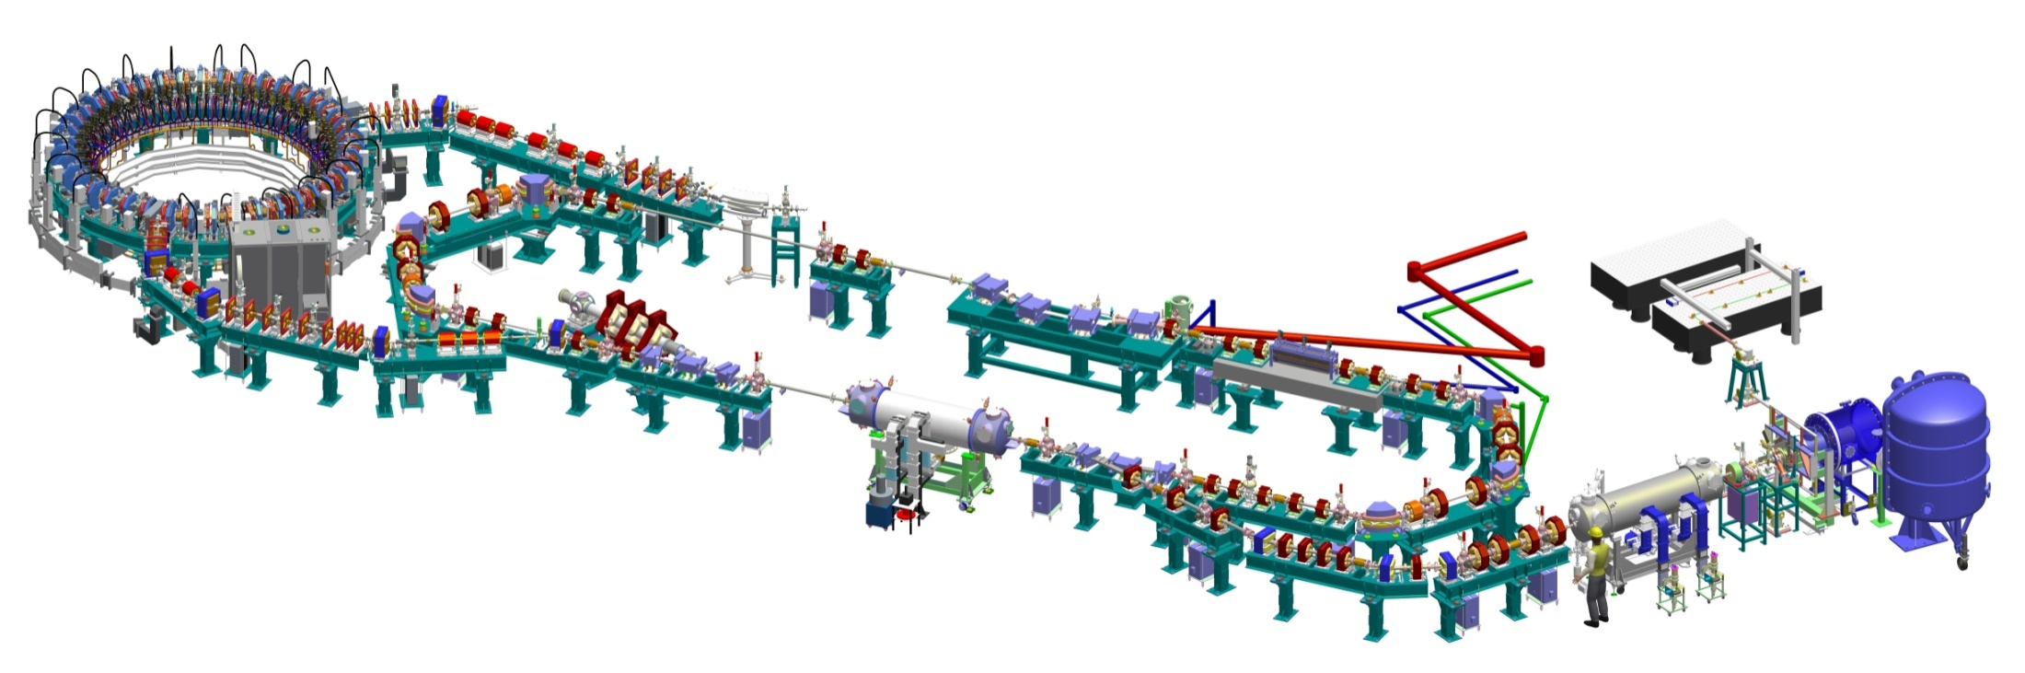
Accelerators and Lasers In Combined Experiments
An accelerator R&D facility @Daresbury Laboratory based on a superconducting energy recovery linac
EMMA
1st arc (translatable)
bunch compressor
chicane
ALICE
photoinjector
laser
TW laser
THz beamline
beam
dump
superconducting linac
DC gun
2nd arc
(fixed)
500KV PSU
superconducting
booster

Slide 3
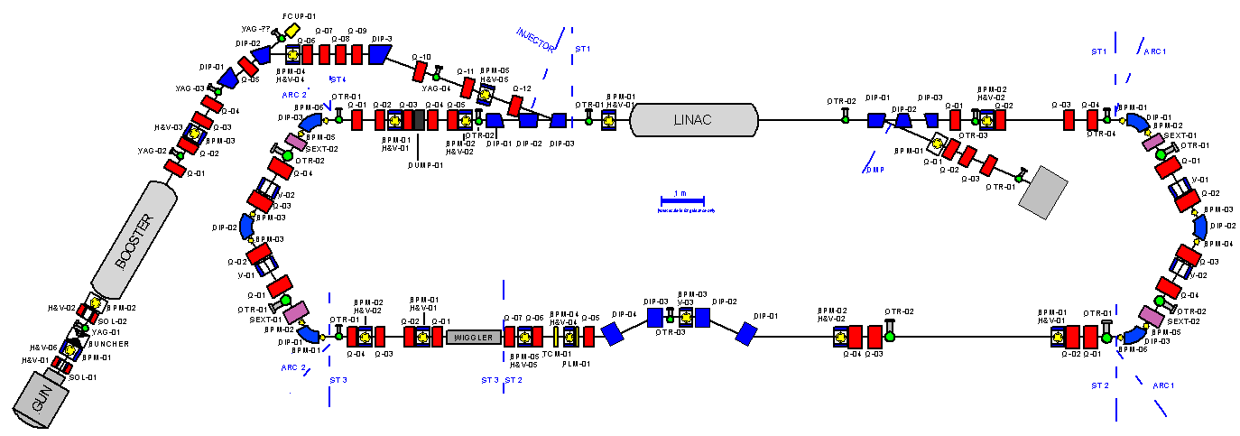
ALICE Machine Description
RF System
Superconducting booster + linac
9-cell cavities. 1.3 GHz, ~10 MV/m.
Pulsed up to 10 Hz, 100 μS bunch trains
Beam transport system.
Triple bend achromatic arcs.
First arc isochronous
Bunch compression chicane R₅₆ = 28 cm
Undulator
Oscillator type FEL
Variable gap
Diagnostics
YAG/OTR screens + stripline BPMs
Electro-optic bunch profile monitor
TW laser
For Compton Backscattering
and EO
~70 fS duration, 10 Hz
Ti Sapphire
DC Gun + Photo Injector Laser
230 kV
GaAs cathode
Up to 100 pC bunch charge
Up to 81.25 MHz rep rate
THz, FEL
BAM

Slide 4
ALICE : Operational Parameters
Parameter | Design | Operating | Units
Bunch charge | 80 | 20 - 80 | pC
Gun energy | 350 | 230 | kV
Booster energy | 8.35 | 6.5 | MeV
Linac energy | 35 | 27.5 | MeV
Repetition rate | 81.25 | 16.25 - 81.25 | MHz
ALICE operates in variety of modes for different experiments : FEL, THz, EMMA, etc differing in requirements for Beam energies, Bunch lengths, Bunch charges, Energy spread, etc
Gun voltage limited by ceramic – replaced recently
Linac energy and bunch repetition rate is limited by beam loading, replacing cryomodule with new DICC module towards end of this year.

Slide 5
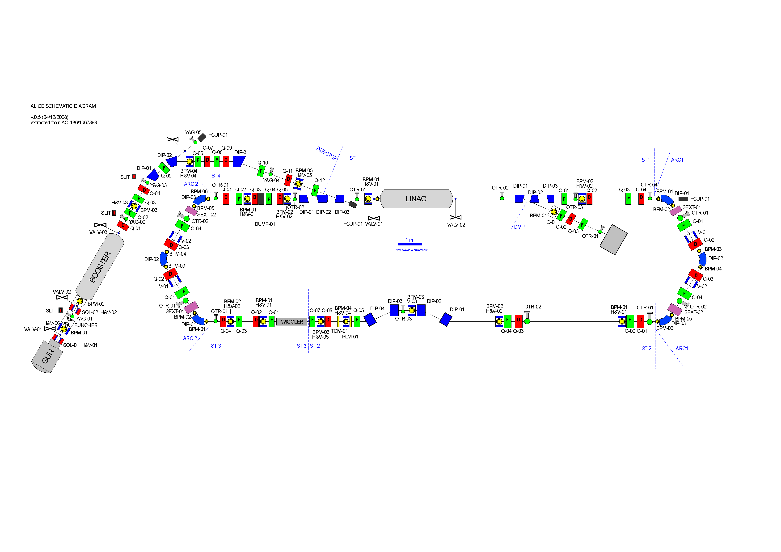
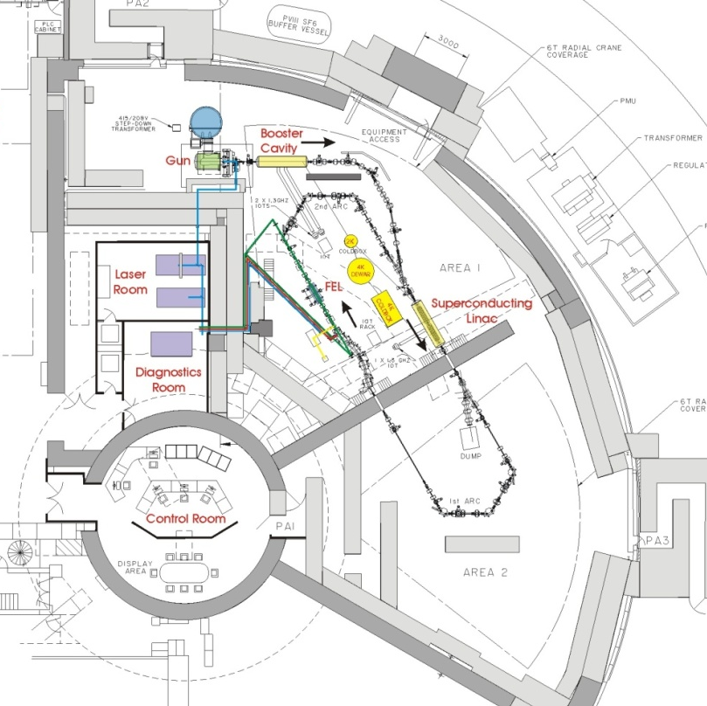
ALICE Injector Layout
Layout restricted by building
Long (~10m) transport line between booster and linac

Slide 6
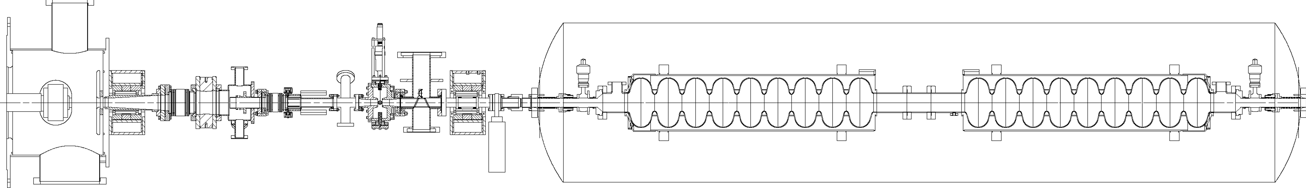
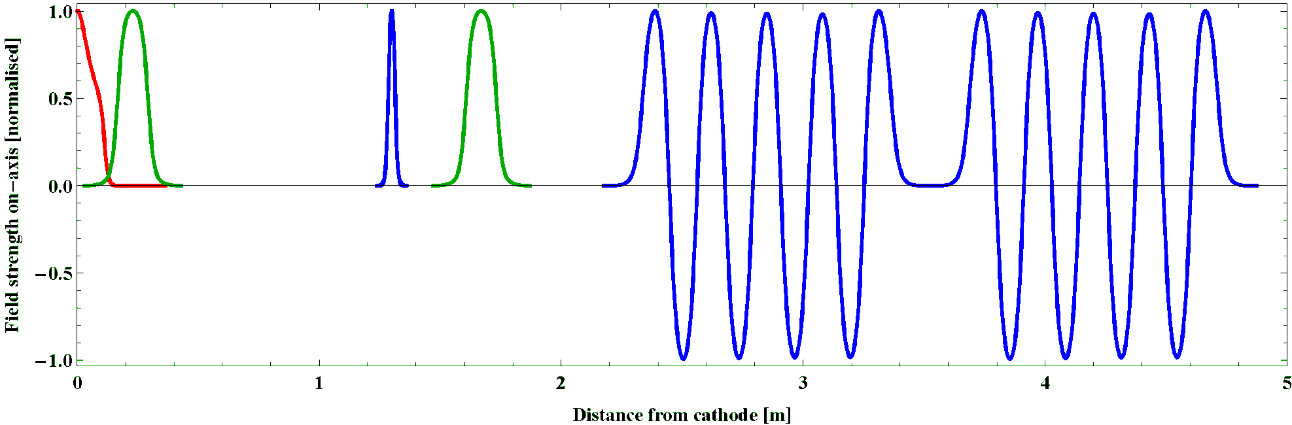
Injector Layout
DC electron gun
JLab FEL
GaAs photocathodes
buncher
solenoid
Booster cavities
solenoid
0.23 m
1.3 m
1.67 m
2.32 m
3.5 m
5 m

Slide 7
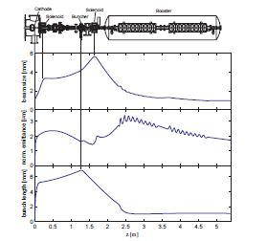
ALICE Simulations - ASTRA
ASTRA was used in the design stage of ALICE (then called ‘ERLP’) injector¹ (2003-2004)
  80 pC, 350 keV gun, 8.35 MeV injector, 35 MeV Linac
Re-modelled before commissioning taking into account apertures in the machine (particularly small in the buncher) and more realistic laser parameters
During injector commissioning (2007) diagnostics line was used for dedicated measurements and comparison with ASTRA²
Only cathode → booster exit was simulated initially (i.e. no dipoles)
Initial ASTRA simulation of injection line measurements
ASTRA vs. measurements in injector diagnostics line
¹C. Gerth et al ”Injector Design for the 4GLS Energy Recovery Linac Prototype”, EPAC ’04
2 Y. Saveliev et al “Characterisation of Electron Bunches from ALICE (ERLP) DC Photoinjector Gun at Two Different Laser Pulse Lengths”, EPAC ’08

Slide 8
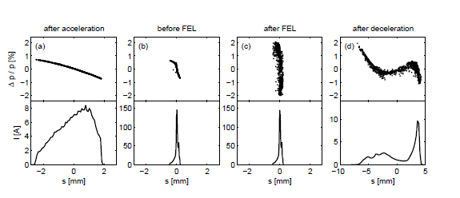
ALICE Simulations - ASTRA
ASTRA (without dipoles-replaced with quads) and GPT (with dipoles) compared for space charge effects in the injection line¹.
‘Start-to-end’ simulation used ELEGANT to track ASTRA results from booster exit through FEL to final beam dump²
Current modelling for comparison to real machine^{3,4,5}
  20-80 pC, 230 keV gun, 6.5 MeV injector, 27.5 MeV Linac
ASTRA-ELEGANT start-to-end simulations
Energy spread and bunch length
1. B. Muratori et al, “Space charge effects for the ERL prototype injector line at Daresbury”, EPAC2005
2. C. Gerth et al, “Start-to-end Simulations of the Energy Recovery Linac Prototype FEL”, FEL ’04
3. F. Jackson et al, ”Beam dynamics at the ALICE accelerator R&D facility”, IPAC11
4 J. McKenzie et al, “Longitudinal Dynamics in the ALICE Injection Line”, ERL11
5 Y. Saveliev et al, “Investigation of beam dynamics with not-ideal electron beam on ALICE ERL”, ERL11

Slide 9
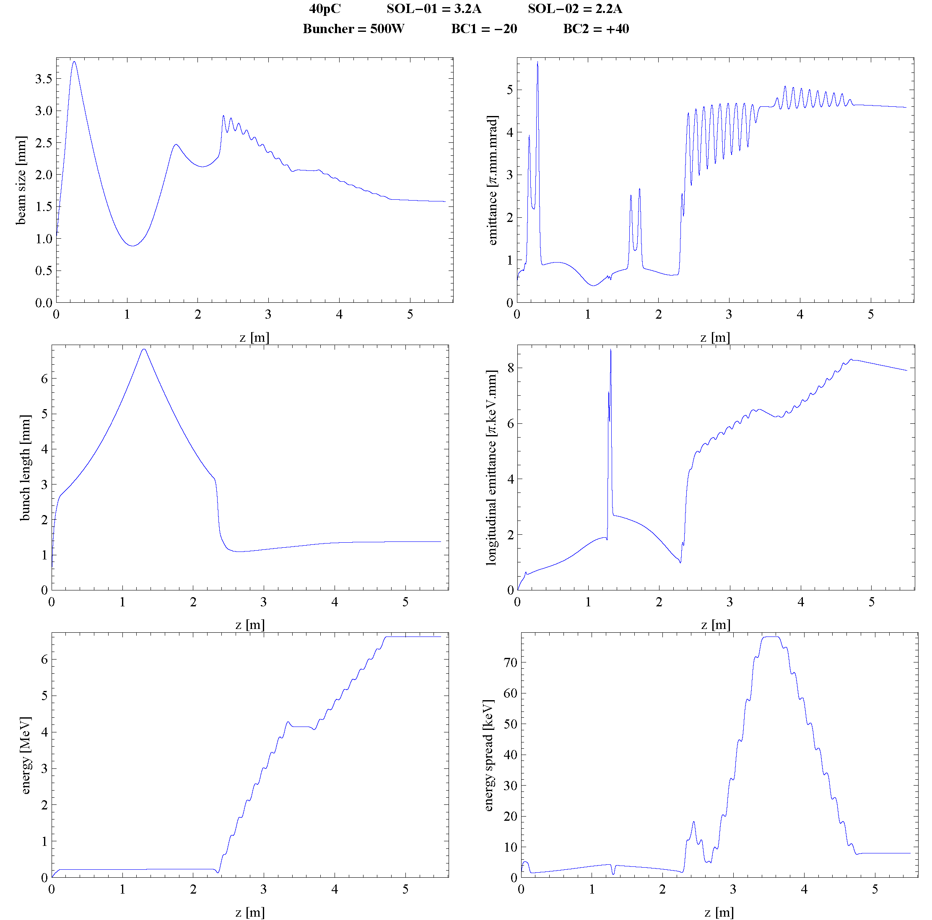
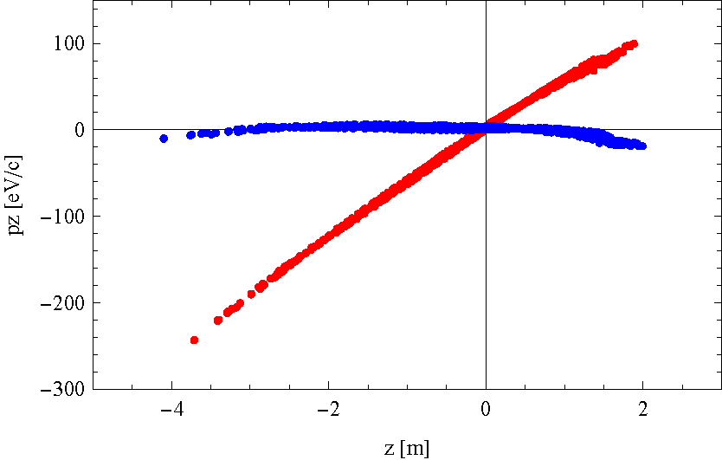
Energy spread
Bunch length
~28 ps laser pulse formed by stacking 7ps Gaussian pulses
Doesn’t provide ideal flat-top
Laser temporal profile in 2008
Red = after BC1
Blue = after BC2
BC2 phase used to compensate energy spread from first cavity by rotating the chirp in longitudinal phase space.

Slide 10
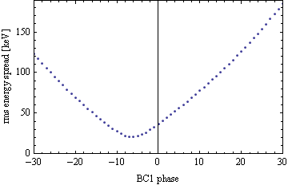
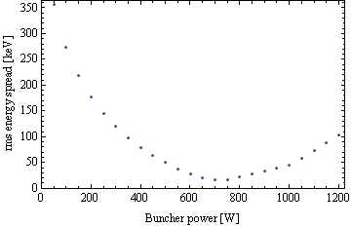
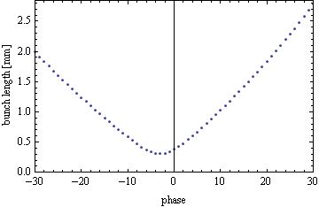
The effect of varying the buncher and BC1 phase on the longitudinal dynamics in the injector
BC1 Phase
-20deg
-10deg
-5deg
The beam is not highly-relativistic in first cells of BC1, and the bunch sees a different phase in each cell as it is accelerated. This leads to non linear effects in the longitudinal phase space, and a ‘hook’ developing at phases close to crest.
Although shorter bunch lengths are achieved near crest, the intrinsic energy spread is poorer due to these effects.

Slide 11
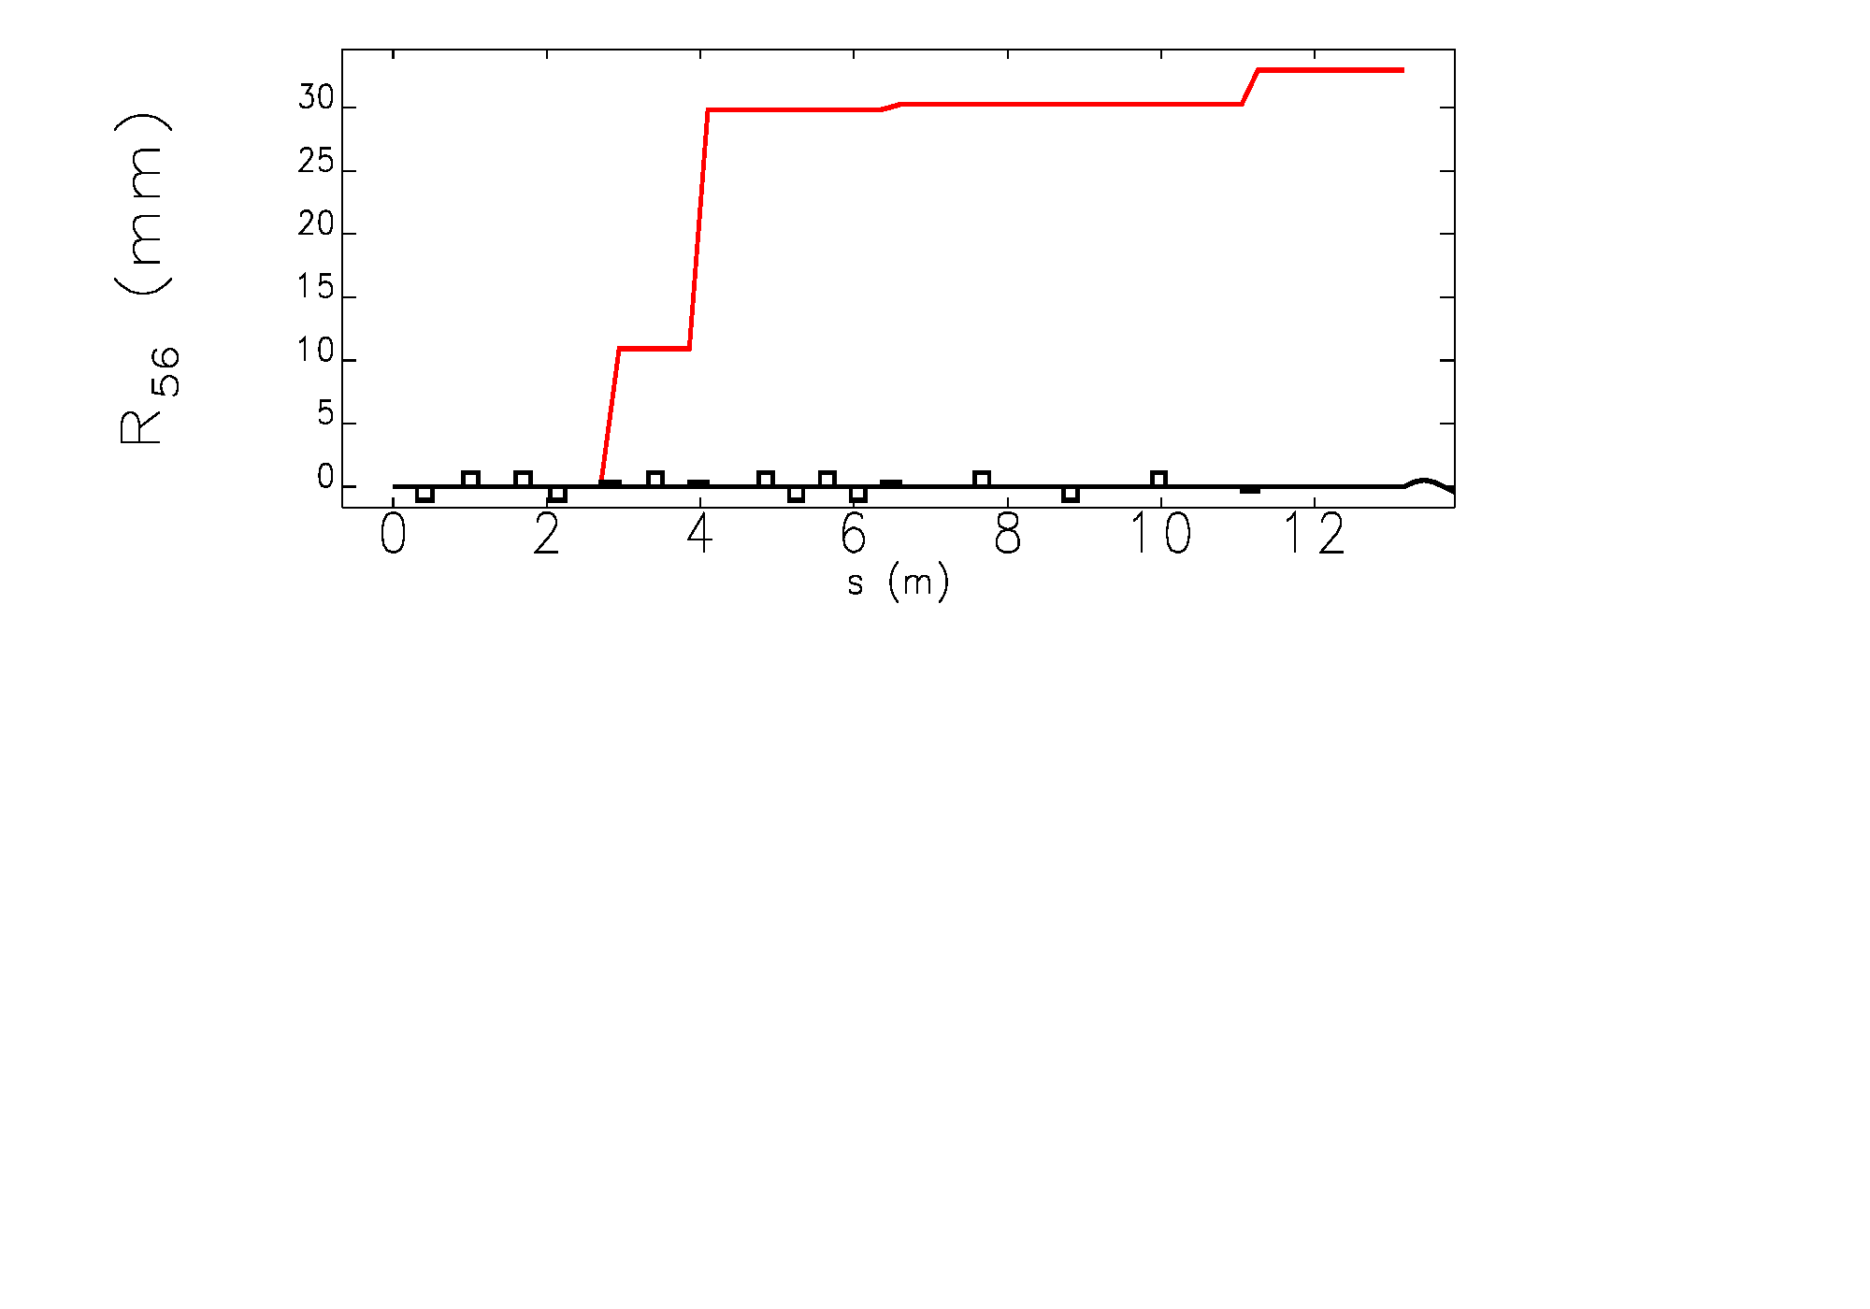
Compression in booster to linac transport line
Total R56 of injection line ~30mm
Very small compared to 28cm in chicane
However, it is of the right sign to compress bunch if chirp not fully compensated by BC2 (For bunch compression setups tend to leave some positive energy chirp from BC2 (+10 to +40deg))
ELEGANT simulations can show compression but don’t take into account all effects, space charge still important at 6 MeV

Slide 12
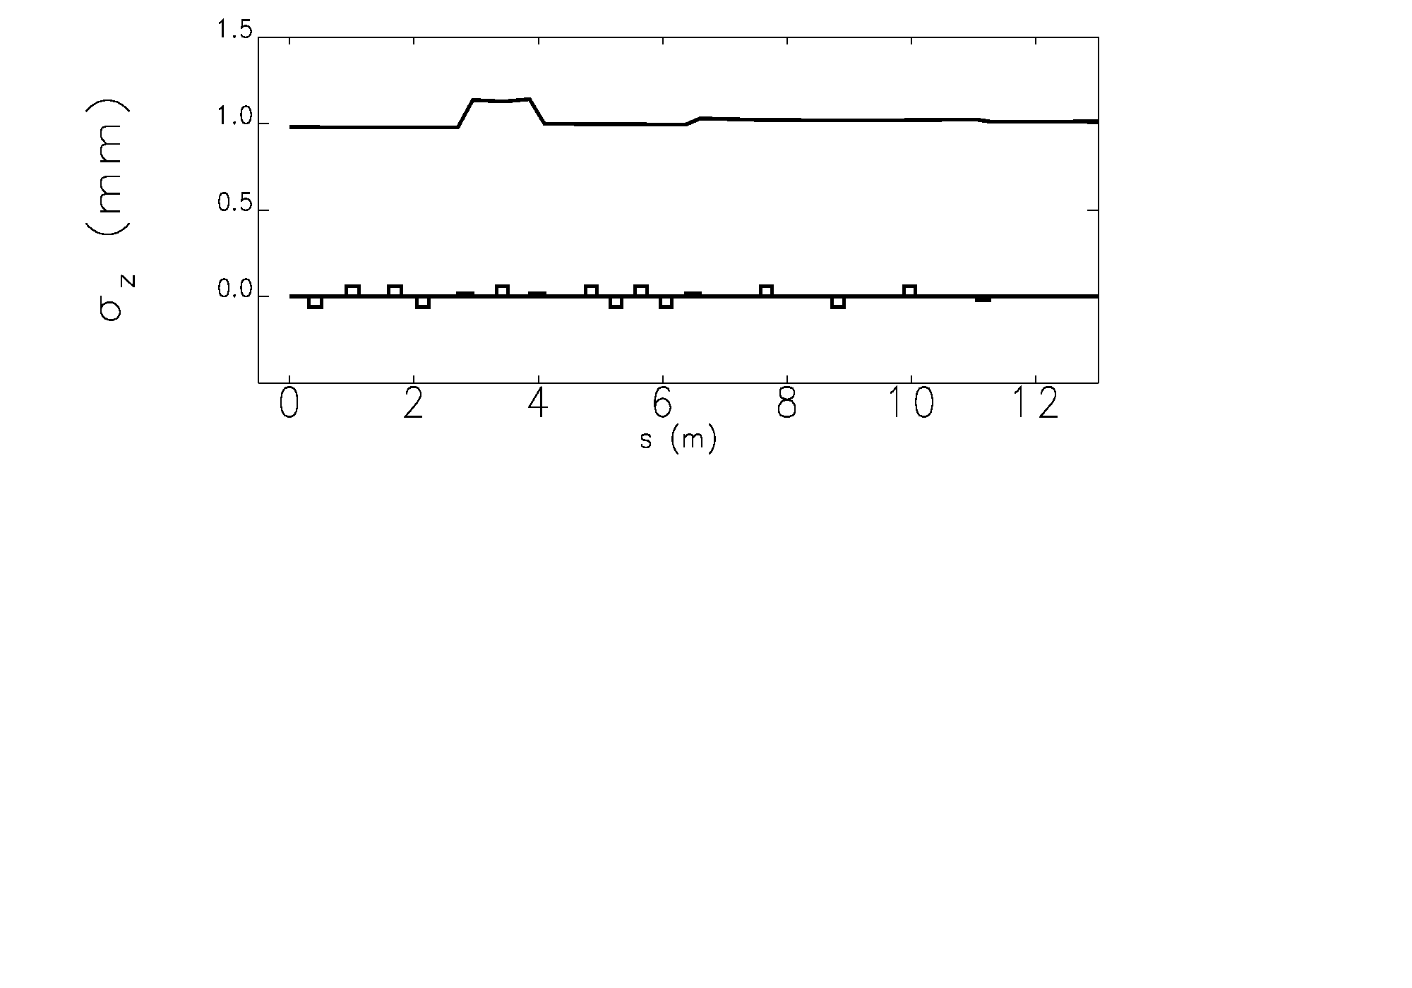
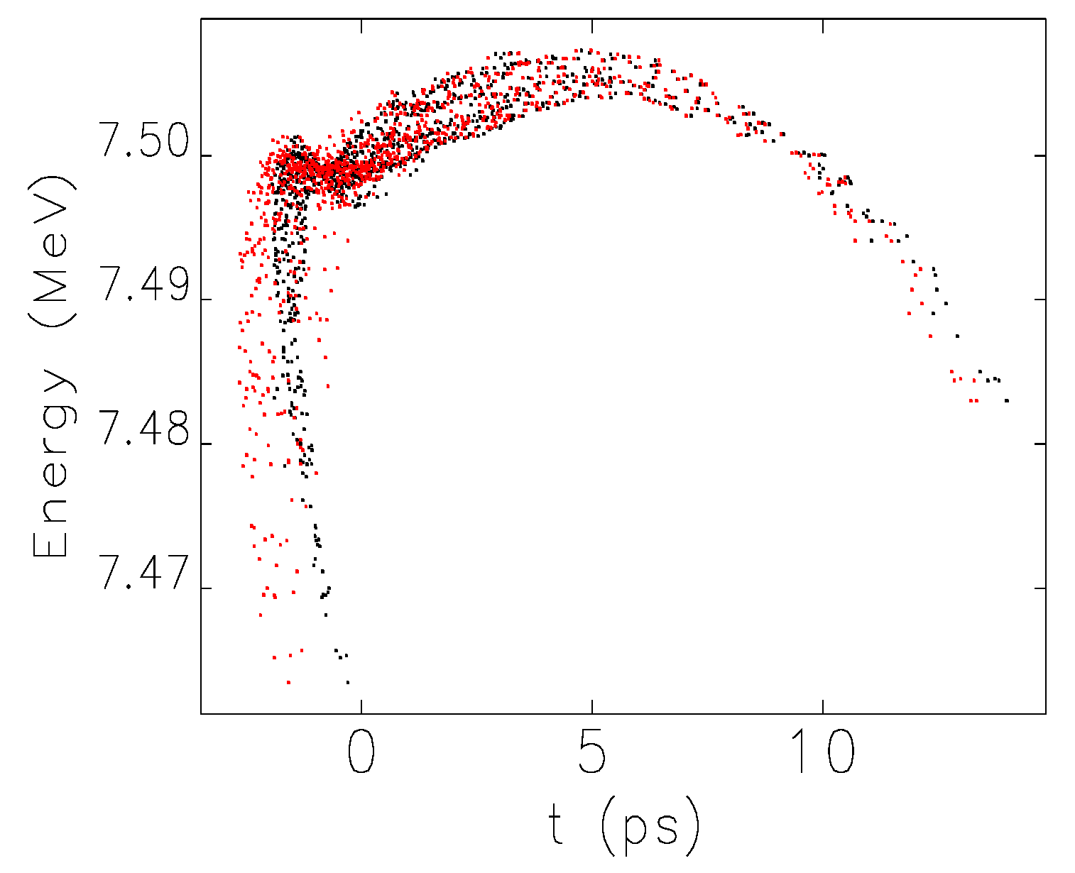
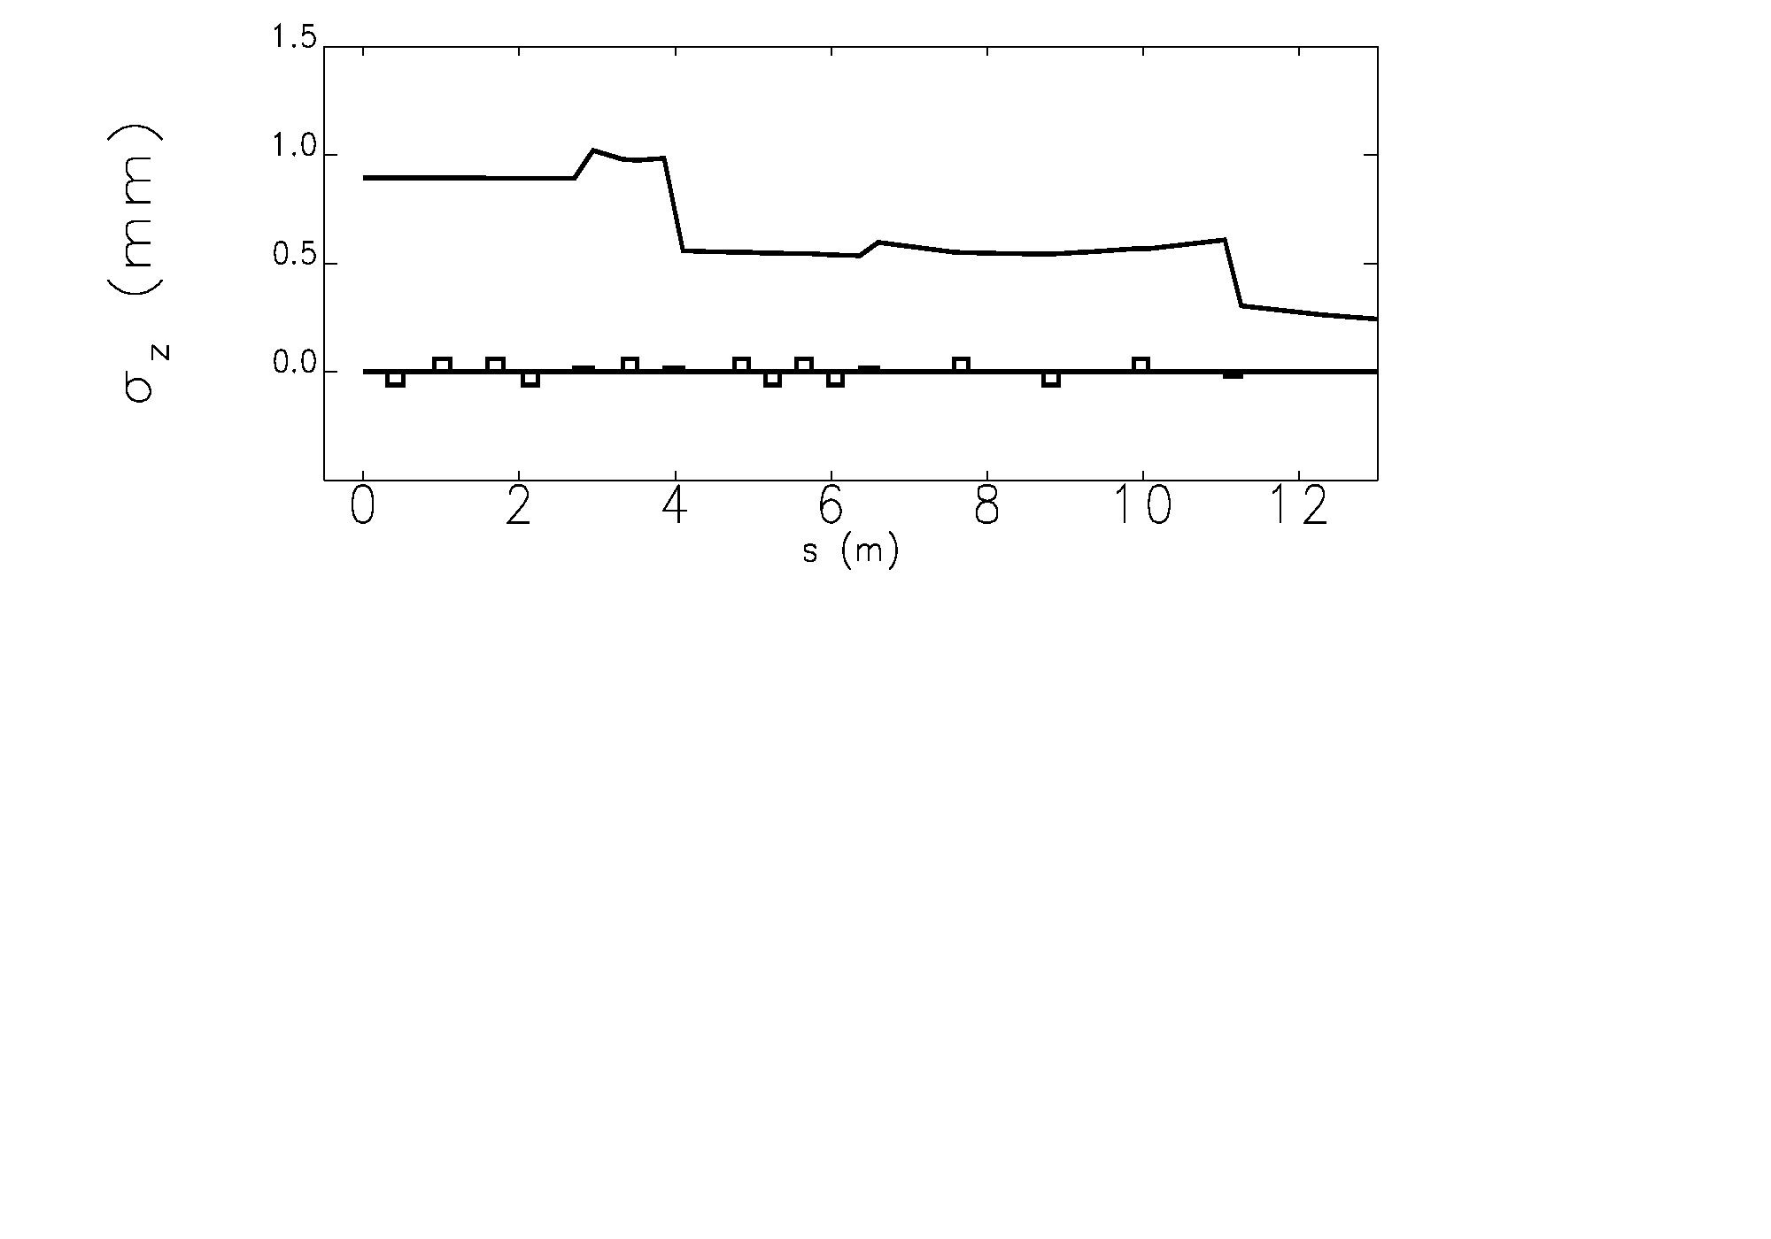
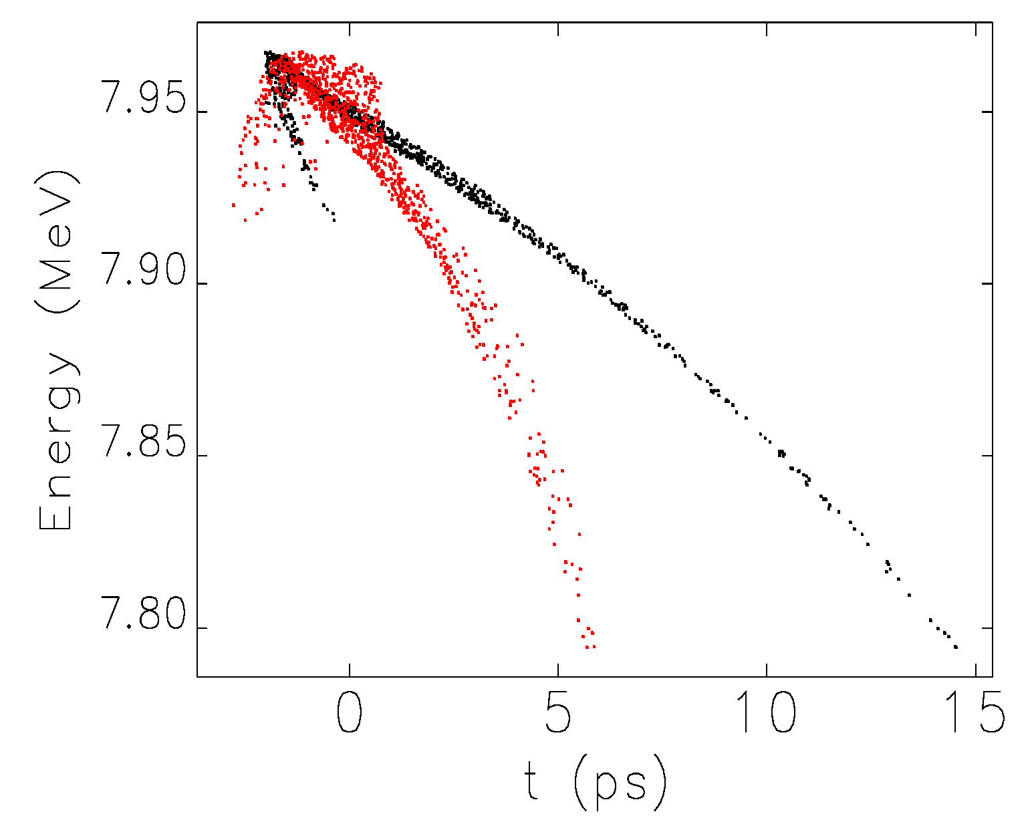
Elegant Simulations
Unchirped bunch
Black = After booster
Red = Before linac
Chirped bunch

Slide 13
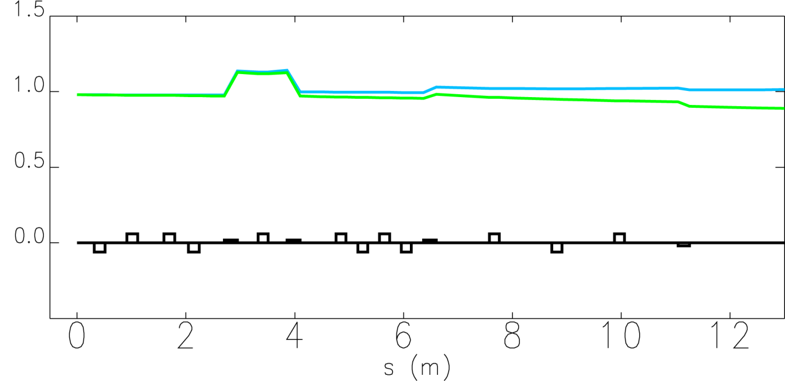
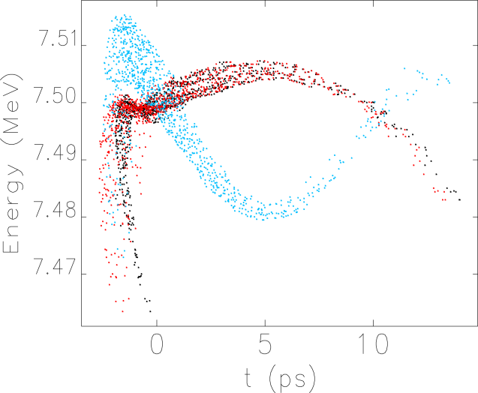
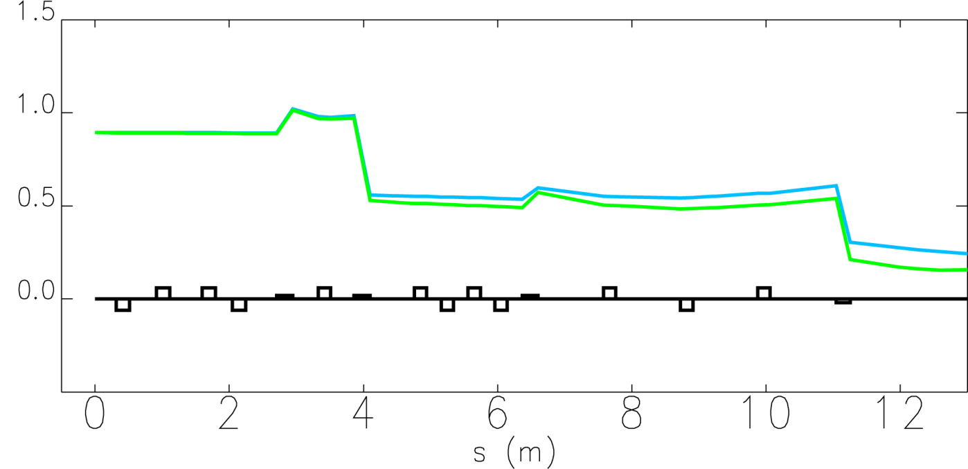
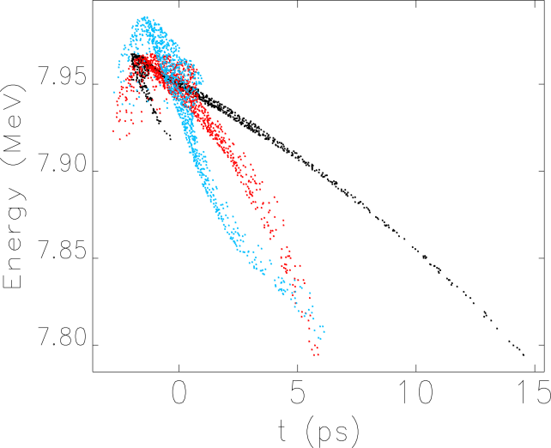
Elegant with LSC on
Unchirped bunch
Black = After booster
Red = Linac, no LSC
Blue = Linac, with LSC
Chirped bunch

Slide 14
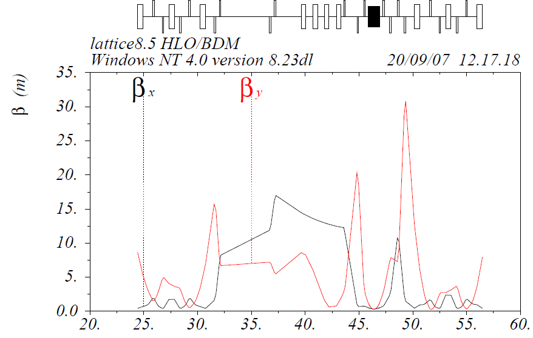
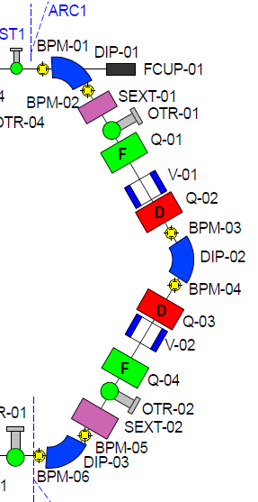
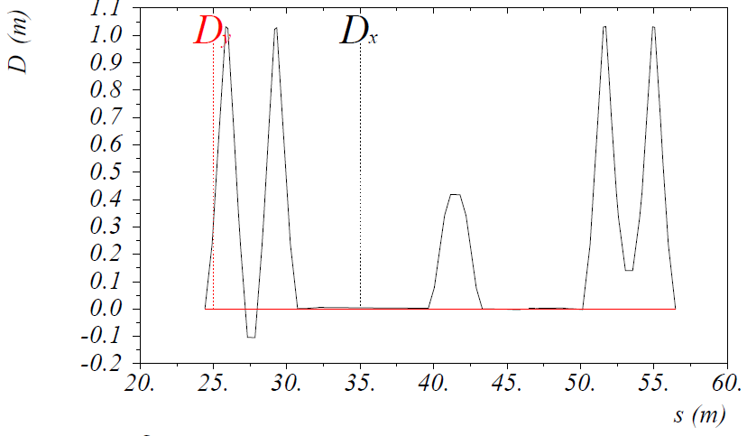
Beam optics: Arc1-to-Arc2
Undulator
compression
chicane
ARC 1
ARC 2
ARC 2
for R56=28cm, would need linac phase of +10deg
but need to compensate energy chirp in the bunch coming from injector from 0 to +5 deg; hence overall off-crest phase (for bunch compression) ; +15 / +16deg
Sextupoles in AR1: linearization of curvature (T₅₆₆)
Notes:
14

Slide 15
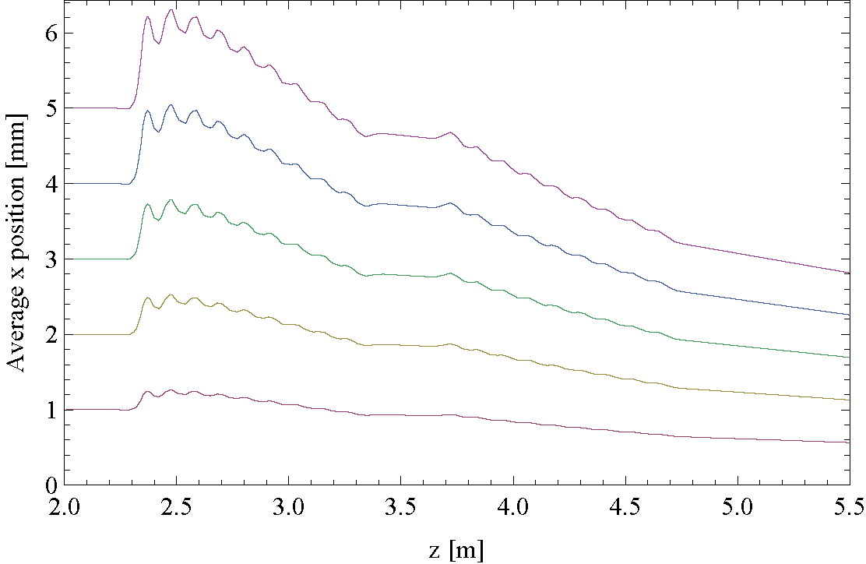
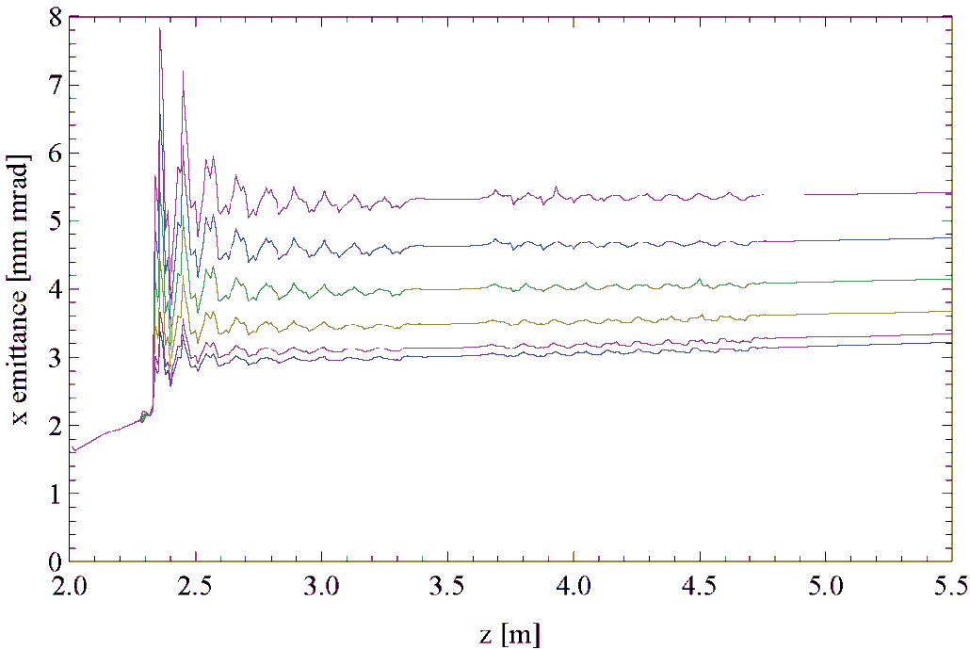
Offset injection into booster
In the real machine, we are never on-axis in the injector beamline.
We start with an offset laser spot and then enter a solenoid.
Plus further effects from stray fields etc.
We have 3 sets of correctors to steer the beam before the booster.
Using GPT, offset the beam from 0 to 5 mm on entrance to the booster:
Barely noticeable changes to bunch length and energy spread
Not much change in beam size
But large change in emittance…

Slide 16
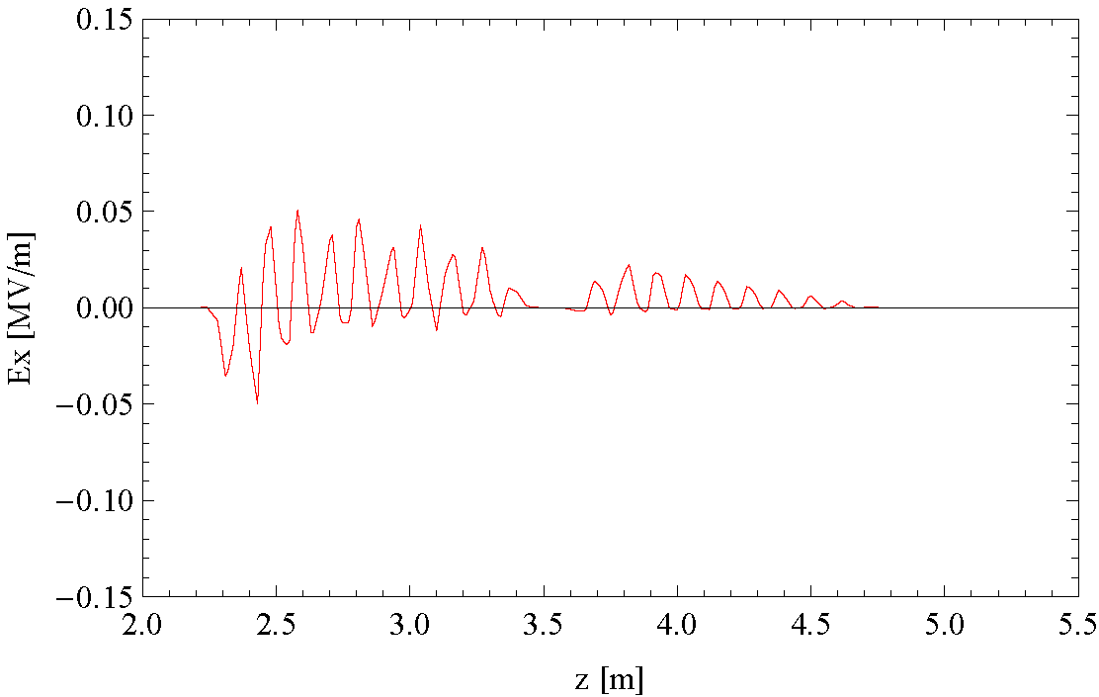
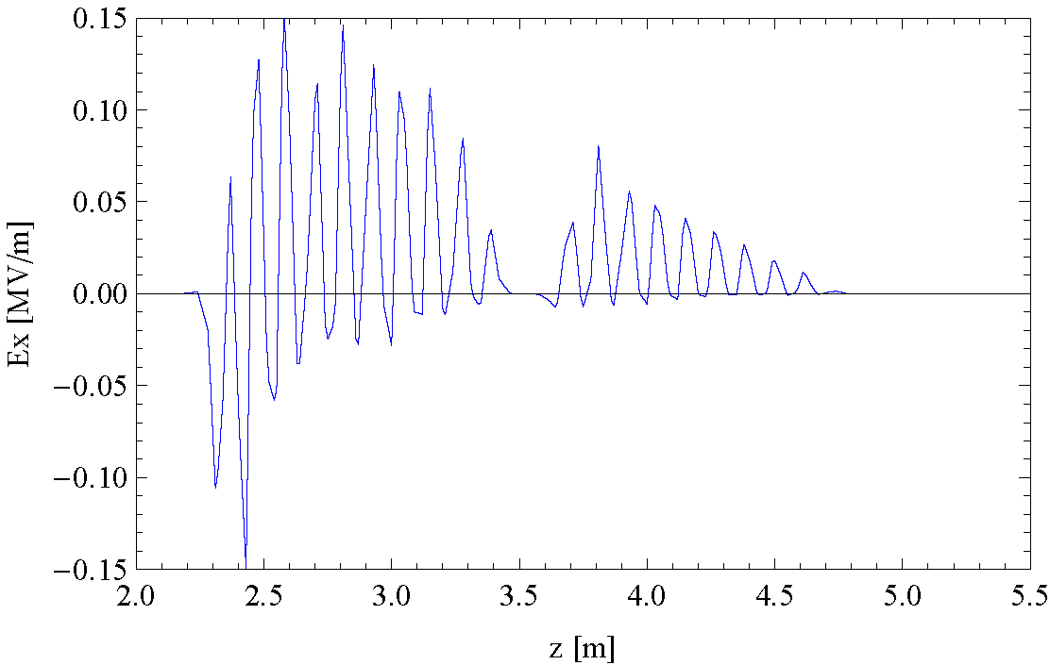
Offset injection into booster
For an offset beam, different parts of each beam see different transverse field from cavity, this leads to the emittance increase observed
1 mm offset probe particle
3 mm offset probe particle

Slide 17
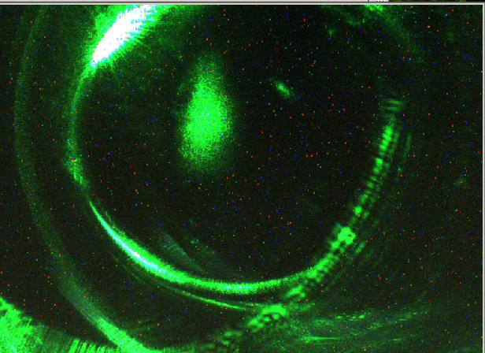
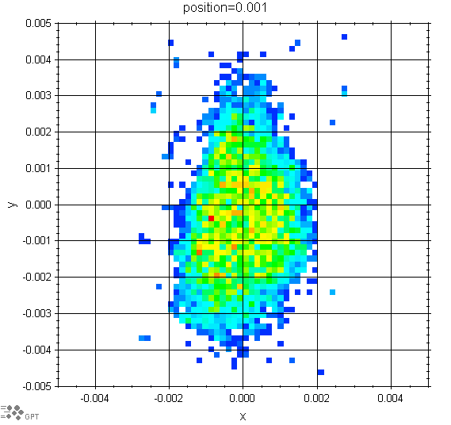

Laser image as input distribution
Previous simulations have always assumed a circular laser spot – often far from reality.
Used a laser image to create an initial distribution for simulations.
Image of laser spot on cathode
(note, not direct image, many reflections etc)
Convert to 8bit greyscale
Input into GPT as initial beam distribution

Slide 18
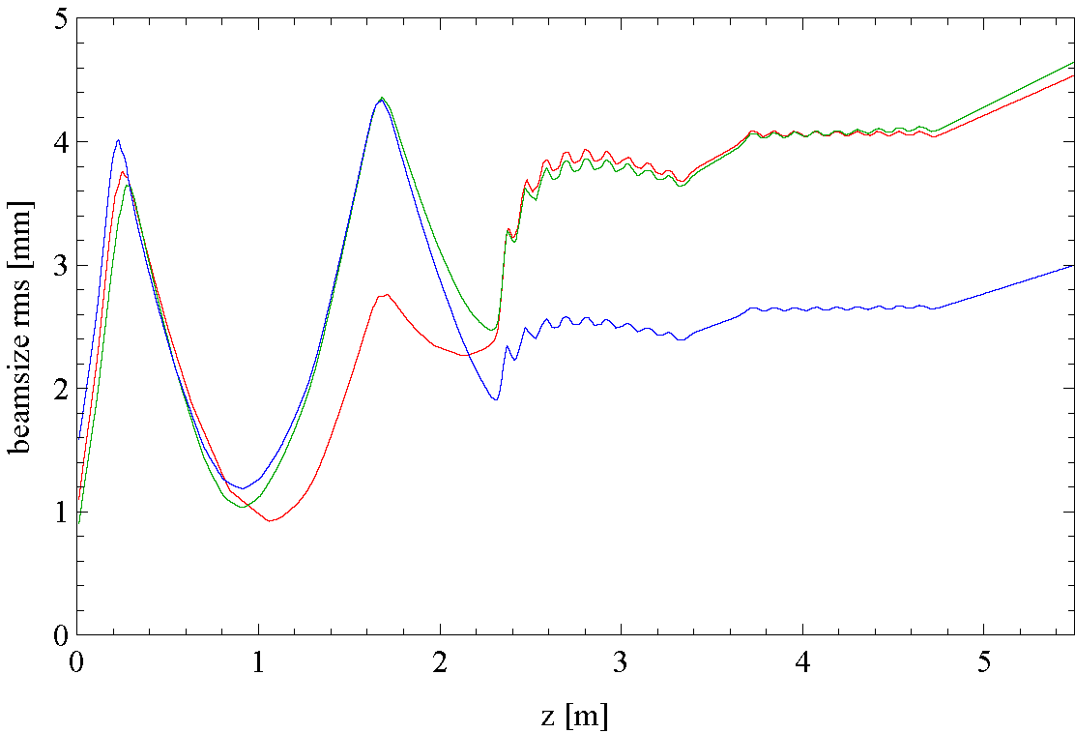
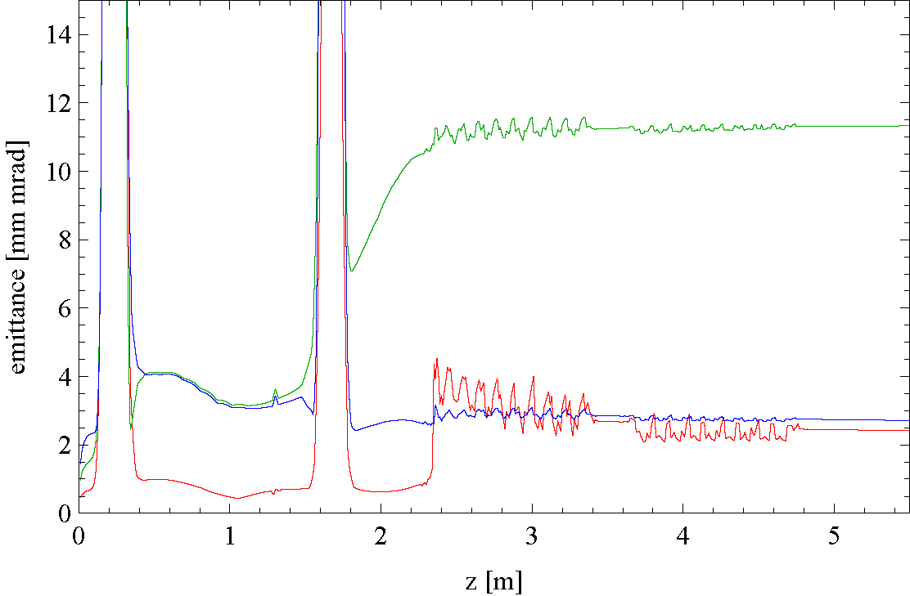
Elliptical vs round laser spots
Note, start with a laser spot with larger y, but beam gets rotated 90 degrees by two solenoids so x is bigger
Red = round beam
Green = elliptical laser image, x
Blue = elliptical laser image, y
Red = round beam
Green = elliptical laser image, x
Blue = elliptical laser image, y

Slide 19
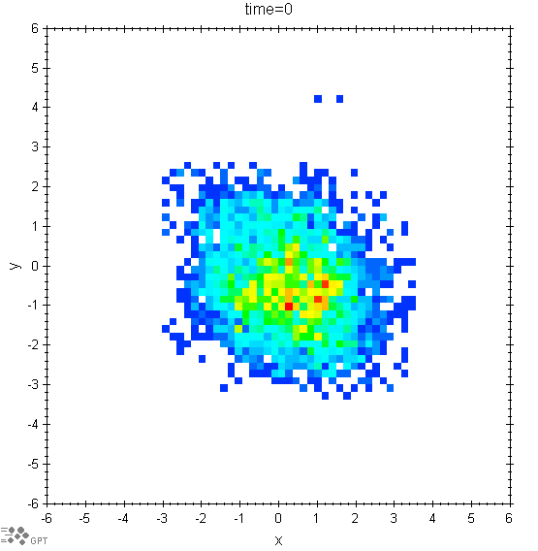
However, in 2011, beam is circular
In the 2010/2011 shutdown, much work was done on the photoinjector laser.
The beam now fairly circular and same initial size as model

Slide 20
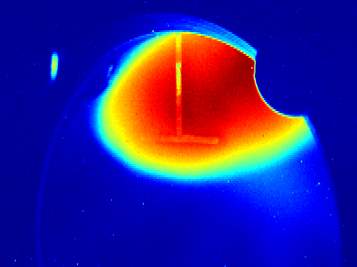
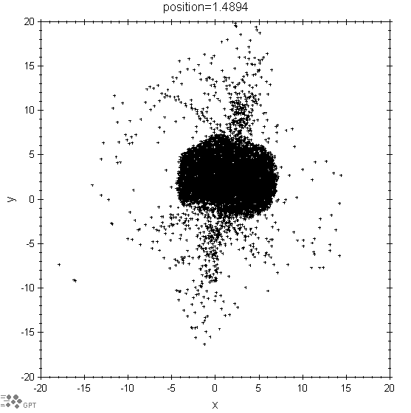
Elliptical beam
However, beam on first screen still elliptical.
Simulations obviously suggest we should have a round beam, however, dimensions roughly match that of the screen image.
Entering solenoid off-centre still produces round beam
Need asymmetric field…
4.65mm
10mm

Slide 21
Stray field measurements
Background fields measured at every accessible pre-booster.
Measured above, below, and on either side of the vacuum vessel.
Ambient level also taken in the injector area.
Lots of interpolation done from these measurements to create a 3D fieldmap for input into GPT.
Lots of errors however, simulations still show the effect of random field errors.
Magnetic field [mT]
Distance from cathode [mm]

Slide 22
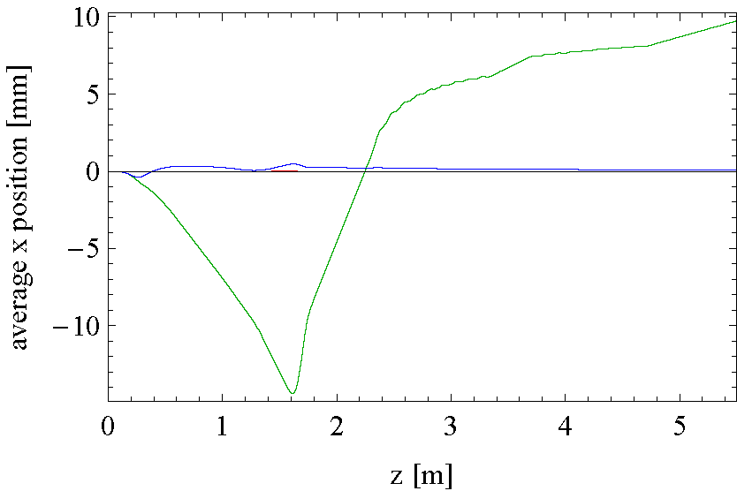
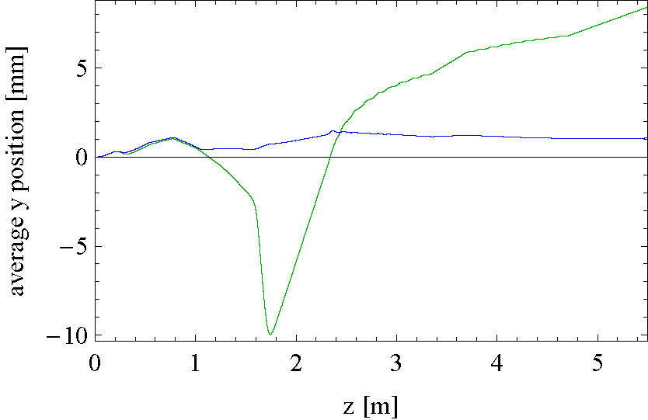
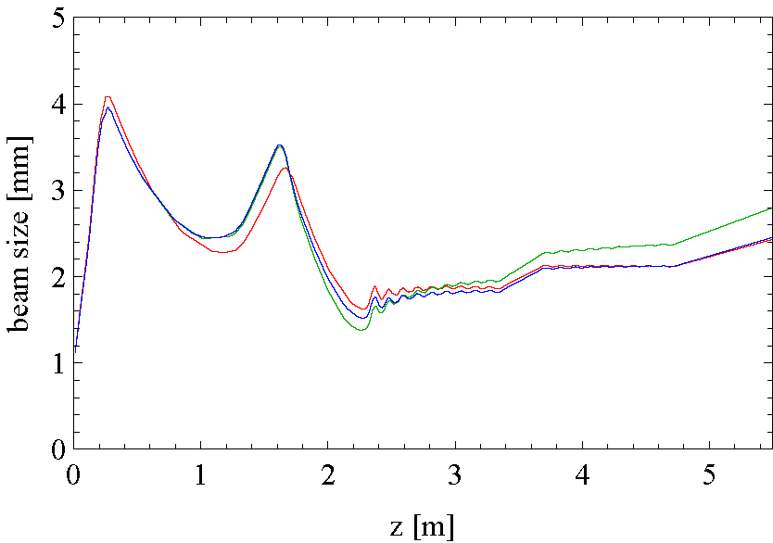
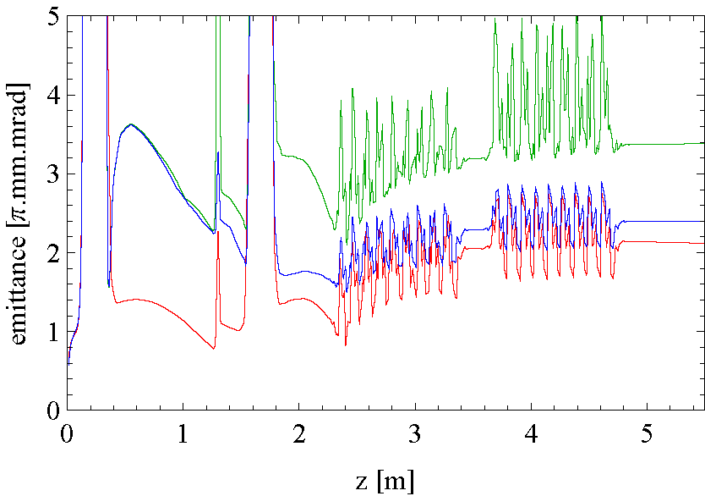
Stray Field Simulations
Simulations performed on the design baseline of 80 pC, 350 keV → 8.35 MeV
Used three correctors pre-booster to centre on the screens before and after the booster
No stray fields (red), stray fields (green), stray fields with corrections (blue)
Note: effect larger at the lower gun energy we currently use

Slide 23
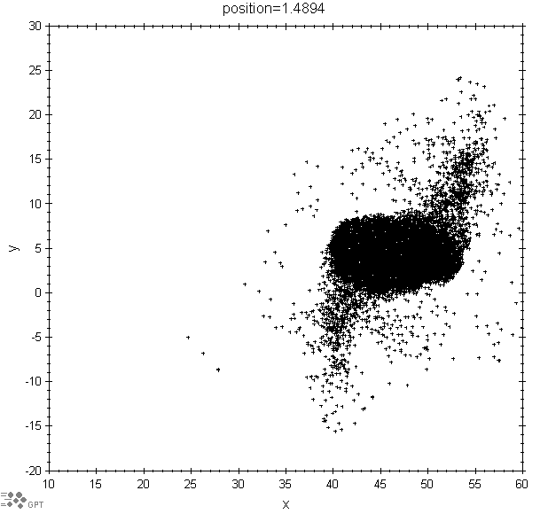
Elliptical beam 2
Back to the elliptical beam on screen 1
Introducing stray fields along the injector produced a beam on the first screen which is approx 15 x 8 mm. Clearly elliptical.
Therefore are stray fields a reason for our elliptical beam?
4.65mm
10mm

Slide 24
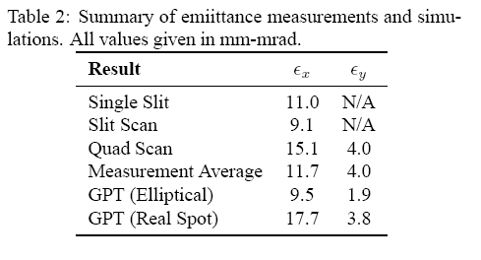
Comparison of emittance measurements
A large variety of emittance measurements have been carried out in the ALICE injector using different methods and different tools to analyse the same data.
One problem is that the measurements have not been made with the same injector setups.
The different methods do not agree but the measurements have always been much larger than simulations (which have always assumed a round laser spot) have suggested.
Using the elliptical distribution and measuring both x and y emittance shows a clearer agreement.

Slide 25
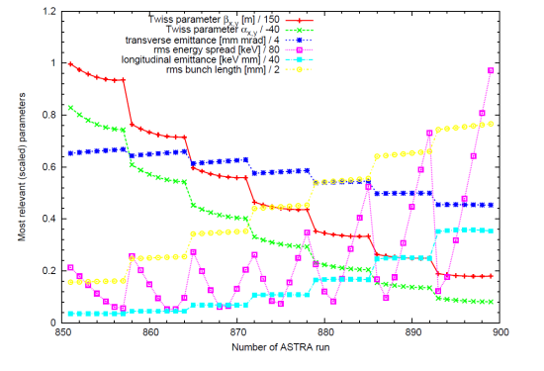
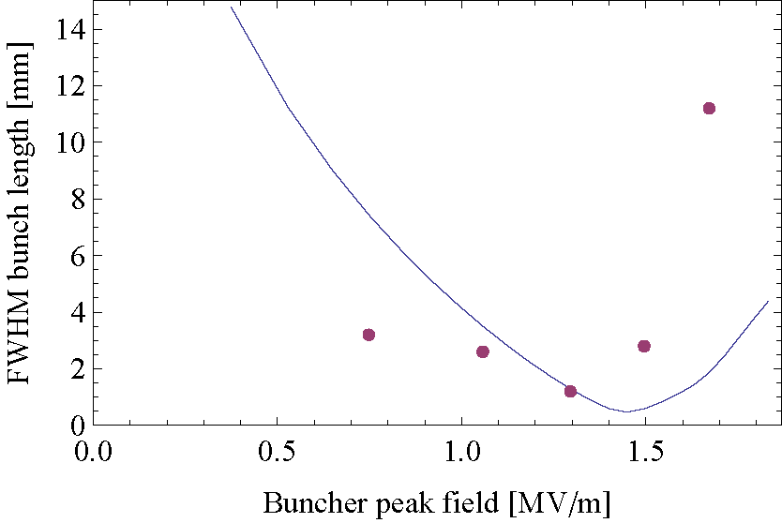
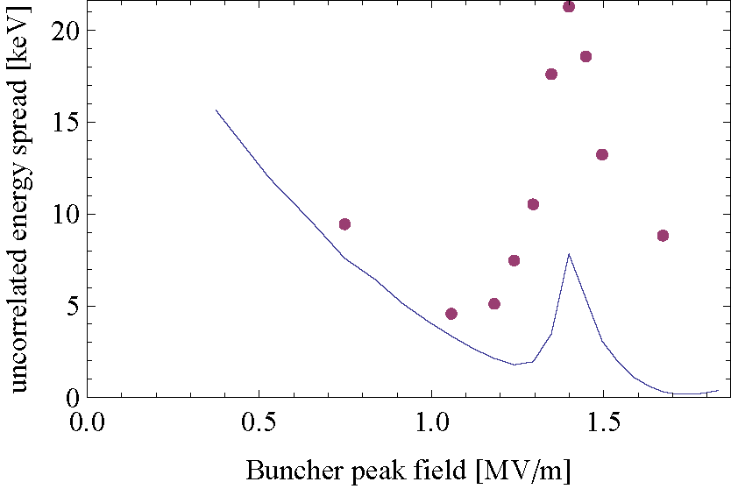
ALICE Simulations - ASTRA
ASTRA continues to be used to re-optimise injector for realistic machine parameters during commissioning.
ASTRA gave guidance on correct buncher and booster parameters required for small energy spread and bunch length, essential for FEL and THz operation
ASTRA global optimisation of injector parameters for optimum beam with realistic constraints
Line –ASTRA
Dot - Expt
Individual parameter scans in ASTRA + measurements

Slide 26
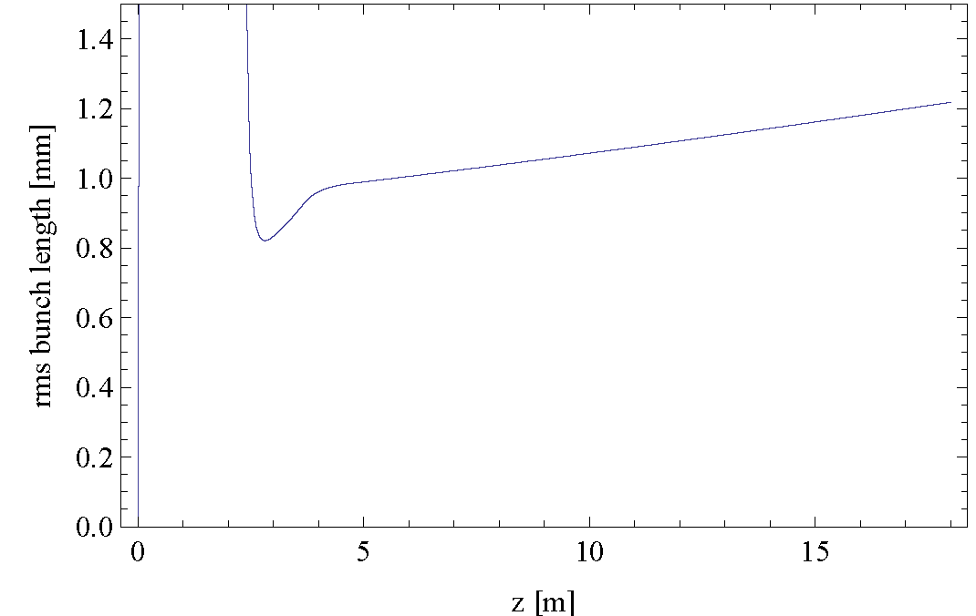
ALICE Simulations - ASTRA
These simulations + experimental experience highlighted the importance of effects like velocity de-bunching and non-zero R56 in the injector.
But ASTRA simulation of the whole injection line (including dipoles), to include all effects together, has not been achieved so far.
Velocity debunching (ASTRA) and magnetic compression (ASTRA+ELEGANT)

Slide 27
ALICE Simulations - ASTRA
Problems implementing full injector line with bends in ASTRA, mainly due to the global co-ordinate frame used in ASTRA
Makes beamline geometry difficult to define and beam trajectory is sensitive to geometry errors
Also makes diagnostic screens difficult to simulate since ASTRA “screen” orientation w.r.t. beam axis difficult to define correctly

Slide 28
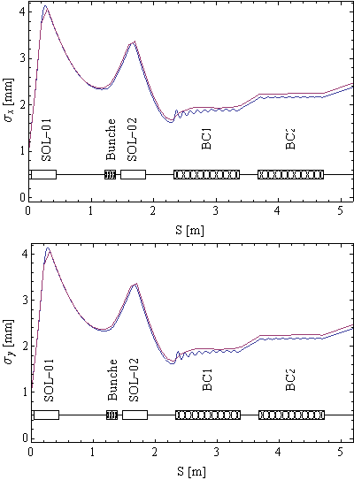
ALICE Simulations - GPT
Gun and injector line design has been modelled in GPT, and compared to original ASTRA model
  Analysis shows that ASTRA and GPT agree very well
  Differences mainly due to space-charge meshes, as well as small differences between different versions
GPT model also includes full injector (cathode to linac)
  Comparisons between GPT and MAD/Elegant show “relatively” good agreement without space-charge
  Re-matched injector (in GPT) with space-charge also shows good agreement
ASTRA
GPT
ASTRA
GPT

Slide 29
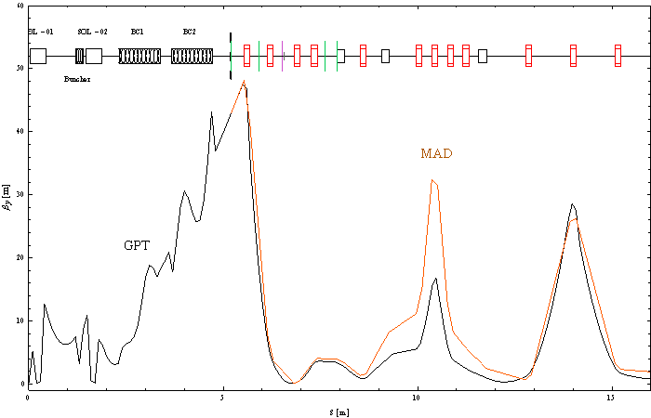
ALICE Simulations - GPT
GPT model post-linac has issues
  Analysis of focusing in extraction chicane dipoles does not agree between MAD and GPT
Comparison between “Real” machine settings and GPT model agree reasonably well in the injector
  Slight tweaks to post-booster matching quadrupoles improve agreement
  Low gun voltage (230kV) and gun beamline steering suspected to account for most of the differences
Space charge off for comparison
Agreement quite good in longitudinal plane as well – not shown here

Slide 30
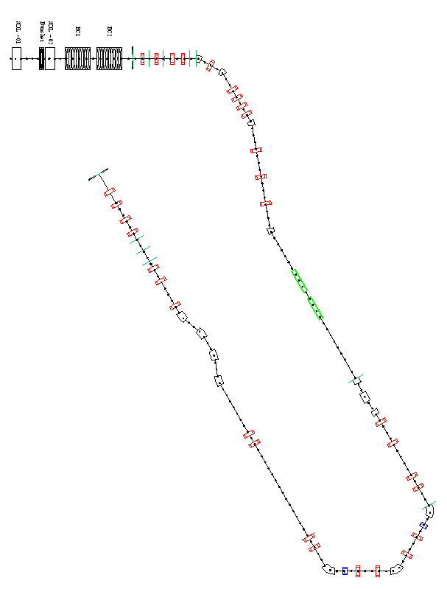
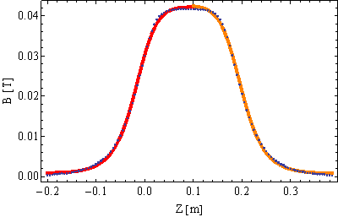
ALICE Modelling - GPT
Gun beamline taken from ASTRA model
Injector design mapped automatically from MAD model
Dipole fringe-field parameters taken from fitting 2D field maps
  Dipole magnetic lengths optimised to minimise steering effects from fringe fields
Quadrupole fields can be taken directly from the machine
  Based on measured calibration curves of Field vs. current

Slide 31



ALICE Modelling - GPT
GPT linac model different to MAD model (Space charge – on in injector, off in rest of the machine)
Post-linac extraction chicane dipoles differ between MAD/GPT
Re-match in MAD post-extraction chicane:
FEL
βx (m)
βy (m)
Bunch-length vs. Linac Phase
Energy Spread vs. Linac Phase

Slide 32
Conclusions
The nature of ALICE accelerator R&D and experiments require different operating regimes.
Injector dynamics complicated by reduced gun energy, long multi-cell booster cavity and long transfer line.
Simulations/measurements still not fully understood – more investigations under way
Significant effort recently to simulate full machine with ASTRA and GPT. Non trivial to use dipoles. Making good progress with GPT. Need another code for comparison? (PARMELA , IMPACT)
During this commissioning period, ALICE will operate at higher gun voltage (350 KV) with new photocathode. Some additional beam diagnostics will also be available which will help to understand some beam dynamics issues. We hope to progress on validating 6D machine model this year.
Notes:
32

Slide 33


Thanks to all the ALICE team!

